Slide 1
Artificial Intelligence
Chapter 24
Communication among Agents
Biointelligence Lab
School of Computer Sci. & Eng.
Seoul National University

Slide 2
Outline
Speech Acts
Planning Speech Acts
Efficient Communication
Natural Language Processing
(C) 2000-2002 SNU CSE Biointelligence Lab

Slide 3
24.1 Speech Acts
Communicative act
  Communicate with other agents in order to affect another agent’s cognitive structure.
Communicative medium
  Sounds, writing, radio
  Communicative acts among humans often involve spoken language.
    So, communicative acts are also called speech acts.
Speaker
Hearer
Speech acts
(C) 2000-2002 SNU CSE Biointelligence Lab

Slide 4
Categories of Speech Acts
Representatives
  Those that state a proposition
Directives
  That request or command
Commissives
  That promise or threaten
Declarations
  That actually change the state of the world, such as “I now pronounce you husband and wife”
(C) 2000-2002 SNU CSE Biointelligence Lab

Slide 5
Utterance
Physical manifestations
  Physical motions
  Acoustic disturbance
  Flashing lights
  Etc.
The utterance must both express the propositional content and the type of the speech act that it manifests.
  E.g. “put block A on block B”
    Request & On(A,B)
(C) 2000-2002 SNU CSE Biointelligence Lab

Slide 6
Perlocutionary and Illocutionary Effects
Speech acts are presumed to have an effect on the hearer’s knowledge
  If our agent A1 commits a representative speech act informing a hearer A2 that a proposition q is true, then A1 can assume that the effect of this act is that A2 knows that A1 intended to inform A2 that q.
Perlocutionary effect
  The effect on the hearer intended by the speaker
Illocutionary effect
  The effect the speech actually has
Indirect speech acts
  Speech acts whose perlocutionary effects are different from what they appear to be.
  E.g. You left the refrigerator door open
(C) 2000-2002 SNU CSE Biointelligence Lab

Slide 7
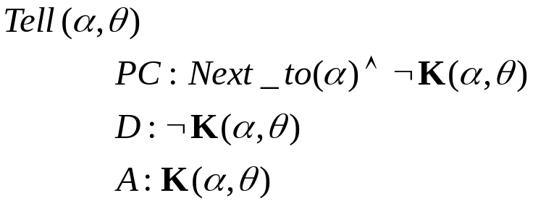
24.2 Planning Speech Acts
We can treat speech acts just like other agent actions
A representative-type speech act in which our agent informs agent a that q is true.
(C) 2000-2002 SNU CSE Biointelligence Lab

Slide 8
Implementing Speech Acts
Direct transmission of a logical formula from speaker to hearer
  Possible if the speaker and hearer share the same kind of feature-based model of the world
  Very limited
Transmission by the speaker of some string of symbols that the hearer then translates into its cognitive structure (perhaps into a logical formula)
  Using agreed-upon, common communication language, e.g. English-like sentences.
(C) 2000-2002 SNU CSE Biointelligence Lab

Slide 9
Understanding Language Strings
Phase-Structure Grammars
Semantic Analysis
Expanding the grammar
(C) 2000-2002 SNU CSE Biointelligence Lab

Slide 10
Phase-structure grammars (1/2)
S ← NP VP | S Conj S
  S ← NP VP
    A sentence, S, is defined to be a noun phrase (NP) followed by a verb phrase (VP).
  S ← S Conj S
    Allow a sentence to be composed, recursively, of a sentence followed by a conjunction (Conj) followed by another sentence.
Conj ← and | or
NP ← N | Adj N
  A noun phrase is defined to be either a noun (N) or an adjective (Adj) followed by a noun.
  N ← A | B | C | block A | block B | block C | floor
VP ← is Adj | is PP
  A verb phrase
(C) 2000-2002 SNU CSE Biointelligence Lab

Slide 11
Phase-structure grammars (2/2)
PP ← Prep NP
  Preposition phrases (PP)
Prep ← on | above | below
  Prepositions (Prep)
(C) 2000-2002 SNU CSE Biointelligence Lab

Slide 12
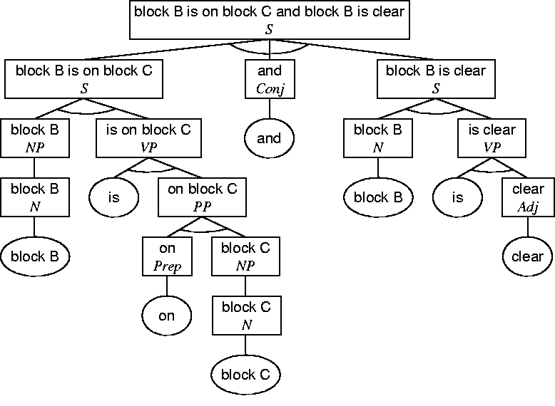
The structure of the sentence “block B is on block C and block B is clear”
(C) 2000-2002 SNU CSE Biointelligence Lab

Slide 13
Parsing
Parsing
  Deciding whether or not an arbitrary string of symbols is a legal sentence
Syntactic analysis
  The parsing process
Various parsing algorithm
  Top-down algorithm
  Bottom-up algorithm
    Usually proceeds in left-to-right fashion along the string
(C) 2000-2002 SNU CSE Biointelligence Lab

Slide 14
Semantic Analysis (1/5)
PP ← Prep NP
  Specify the semantic association for PP in terms of the semantic associations for Prep and NP
  These semantic associations are indicated by expressing each nonterminal symbol as a functional expression; for example, PP(sem)
At the conclusion of parsing, the formula associated with the nonterminal symbol S is then taken to be the meaning of the string.
With these associations, the grammar is called an augmented phrase-structure grammar, and the parsing process accomplishes what is called a semantic analysis.
(C) 2000-2002 SNU CSE Biointelligence Lab

Slide 15
Semantic Analysis (2/5)
N ← A | B | C | block A | block B | block C | floor
A → Noun(E(A))
  The semantic component to be associated with the noun “A” is the atom, E(A)
B → Noun(E(B))
C → Noun(E(C))
block A → Noun(Block(A))
block B → Noun(Block(B))
block C → Noun(Block(C))
floor → Noun(Floor(F1))
(C) 2000-2002 SNU CSE Biointelligence Lab

Slide 16
Semantic Analysis (3/5)
and → Conj(∧)
or → Conj(∨)
clear → Adj(lx Clear(x))
If we apply these rule
  Noun(Block(B)) is on Noun(Block(C)) conj(∧) Noun(block(b)) is Adj(lx Clear(x))
(C) 2000-2002 SNU CSE Biointelligence Lab

Slide 17
Semantic Analysis (4/5)
Noun(q(s)) → NP(q(s))
is Adj(lx q(x)) → VP(lx q(x))
NP(q(s))VP(lx y(x)) → S((lx y(x) ∧q(s))s)
  Condensed rule: NP(q(s))VP(lx y(x)) → S(y(s) ∧ q(s))
on → Prep(lxy On(x,y))
Prep(lxy y(x,y))NP(q(s)) → PP(lx (ly y(x,y) ∧q(s))s)
  Condensed rule: Prep(lxy y(x,y))NP(q(s)) → PP(lx y(x,s) ∧q(s))
is PP(lx y(x,s)) → VP(lx y(x,s))
(C) 2000-2002 SNU CSE Biointelligence Lab

Slide 18
Semantic Analysis (5/5)
If we apply these rule
  NP(Block(B)) is Prep(lxy On(x,y)) NP(Block(C)) Conj(∧) S(Clear(B) ∧Block(B))
  NP(Block(B)) is PP(lx On(x,C)) ∧(Block(C)) Conj(∧) S(Clear(B) ∧ Block(B))
  NP(Block(B)) VP(lx On(x, C)) ∧ (Block(C)) Conj(∧) S(Clear(B) ∧ Block(B))
  S(Block(B)) ∧ Block(C) On(B, C)) Conj(∧) S(Clear(B) ∧ Block(B))
S(g1)Conj(∧)S(g2) → S(g1 ∧ g2)
  S(On(B,C) ∧ Clear(B) ∧ Block(B) ∧ Block(C)
(C) 2000-2002 SNU CSE Biointelligence Lab

Slide 19
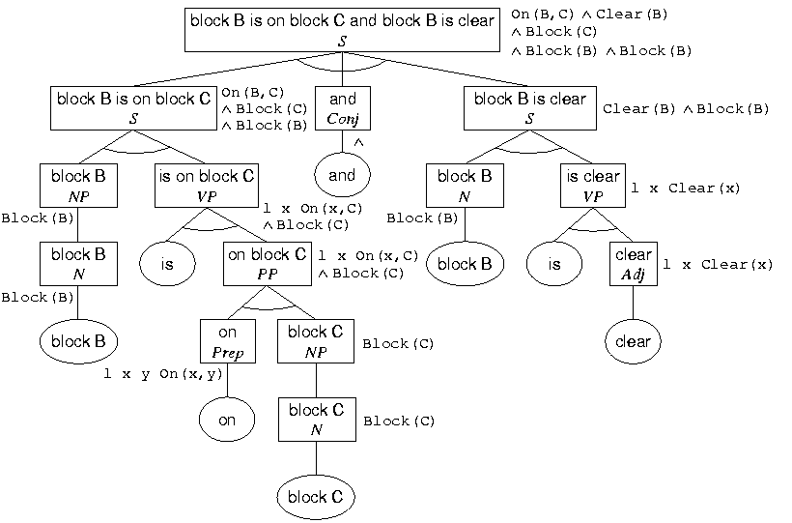
Semantic Parse Tree
(C) 2000-2002 SNU CSE Biointelligence Lab

Slide 20
Expanding the Grammar (1/2)
More adjectives, prepositions and nouns
  Easy to expand
Verbs
  Need Conceptualizing such actions.
Tensed verbs
  Involving translation into a formula capable of describing temporal events
Articles
  Involving translation into quantified formulas
(C) 2000-2002 SNU CSE Biointelligence Lab

Slide 21
Expanding the Grammar (2/2)
English sentences are often ambiguous
  “All blocks are on a block”
  (x)(y)On(x,y) or (y)(x)On(x,y)
  Resolving ambiguities
    Referring to other sources of knowledge
    Quasi-logical form
Sentences in natural languages usually cannot be adequately defined by context-free grammar
  Singular-plural agreement
    S←NP VP might also accept “block A and block B is on block C”
    S(n)←NP(n) VP(n), where n is either “singular” or “plural”
Unification grammars
(C) 2000-2002 SNU CSE Biointelligence Lab

Slide 22
24.3 Efficient Communication
Substantial efficiency of communication
  Can often be achieved by relying on the hearer to use its own knowledge to help determine the meaning of an utterance.
  If a speaker knows that a hearer can figure out what the speaker means, then
    The speaker can send shorter, less self-contained messages.
One of the main reasons why it is so difficult for computers to understand natural languages is
  NL understanding requires many sources of knowledge including knowledge about the context.
(C) 2000-2002 SNU CSE Biointelligence Lab

Slide 23
Use of Context
If the hearer and speaker share the same context
  Then that context can be used as a source of knowledge in determining the meaning of an utterance.
  Use of context
    Allows the language to have pronouns.
    Can include previous communication.
    Current environment situation.
  Ex) “Block A is clear and it is on block B.”
    Hearer can under stand “it” means the “block A” from context.
  Ex) “I know that block A is on block B”
    The hearer can understand which person (or machine) the word “I” refers from context of the utterance.
(C) 2000-2002 SNU CSE Biointelligence Lab

Slide 24
Use of Knowledge to Resolve Ambiguities
Lexical Ambiguity
  The same word can have several different meanings.
    Ex) “Robot R1 is hot.”
Syntactic Ambiguity
  Some sentence can be parsed in more than one way.
    Ex) “I saw R1 in room 37.”
Referential Ambiguity
  The use of pronouns and other anaphora can cause ambiguity.
    Ex) “Block A is on block B and it is not clear.”
Pragmatic Ambiguity
  The process for using knowledge of context and other knowledge for resolving ambiguities.
    Ex) “R1 is in the room with R2.”
(C) 2000-2002 SNU CSE Biointelligence Lab

Slide 25
24.4 Natural Language Processing (1/2)
The subject of Natural Language Processing: NLP
  Immense field with many potential applications, including translation from one language into another, retrieval of information from databases, human/computer interaction, and automatic dictation.
  Has been described as “AI-hard”.
    To produce a system as competent with language as a human is would require solving “the AI problem”.
  Much of the difficulties lies in
    Resolving pragmatic ambiguities which seems to require reasoning over a large commonsense knowledge base and parsing systems adequate to handle natural languages.
(C) 2000-2002 SNU CSE Biointelligence Lab

Slide 26
24.4 Natural Language Processing (2/2)
Ex)
  P: Well, I’ll need to see your printout.
  S: I can’t unlock the door to the small computer room to get it.
  P: Here’s the key.
(C) 2000-2002 SNU CSE Biointelligence Lab

Slide 27
Additional Readings (1/3)
[Cohen & Perrault 1979]
  AI planning system → plan speech acts
[Kautz 1991]
  Plan recognition
[Chomsky 1965]
  Language syntax and syntax analysis
[Pereira & Warren 1980]
  Definite clause grammar
(C) 2000-2002 SNU CSE Biointelligence Lab

Slide 28
Additional Readings (2/3)
[Woods 1970]
  Augmented transition networks: ATN
[Grosz, et al. 1987]
  SRI Internatioanl’s TEAM: typical grammar of English
[Magerman 1993]
  Statistical approach for grammar learning (induction)
[Charniak 1993]
  Rules associated with probabilties
(C) 2000-2002 SNU CSE Biointelligence Lab

Slide 29
Additional Readings (3/3)
[Grosz, Spark Jones & Webber 1986], [Waibel & Lee 1990]
  Papers on natural language processing and speech recognition
[Masand, Linoff, & Waltz 1992, Stanfill & Waltz 1986]
  Vector based text comparison method using word frequency: text categorization, text classification
(C) 2000-2002 SNU CSE Biointelligence Lab

